Slide 1
AI-Powered Farmer-to-Market Advisory System A Holistic Approach with Computer Vision, Large Language Models, and Real-Time Data Integration under the guidance of Mrs. G. V. Leela Kumari
Presented by team(CM13):
M. Suchithra(Y22ACM448)
M. Rahul(Y22ACM451)
S. Balaji(Y22ACM476)

Slide 2
Table of Contents
Abstract
Implementation
Existing System
Results
Proposed System
Conclusion
Design

Slide 3
Abstract
Farmers often lack access to integrated market intelligence combining price trends, weather variability, and logistics costs, leading to suboptimal selling decisions and post-harvest losses. This study proposes an AI driven farmer to market advisory system that integrates computer- vision based crop identification, real time mandi price retrieval, geolocation enabled transport cost estimation, and storage profitability simulation. The framework analyses multimodal data to recommend optimal selling markets and timing strategies aimed at maximizing net profit. Experimental validation using real time agricultural price datasets demonstrates improved decision support accuracy and reduced spoilage risk. The proposed system highlights the potential of AI enabled decision platforms to enhance agricultural marketing efficiency and support data driven farm level economic planning.

Slide 4
Existing System
The agricultural marketing system uses manual price tracking, so farmers rely on word-of-mouth or outdated information, leading to poor selling decisions.
Lack of market information forces farmers to depend on middlemen, which reduces their profits.
Logistical issues arise due to the absence of tools for route planning, weather updates, and transport management.
Crop quality and freshness are judged subjectively, resulting in inaccurate estimation of shelf life and market value.

Slide 5
Proposed System
The proposed system is an AI-based platform using Python and Streamlit that provides real-time market information to farmers.
It automatically collects live prices from AGMARKNET and identifies nearby profitable mandis using geocoding.
AI-based image processing evaluates crop quality and freshness accurately.
The system offers decision support, helping farmers decide the best time to sell for maximum profit.

Slide 6
Future Scope
Implementation of advanced deep learning models to improve prediction accuracy
Support for multiple regional languages to enhance usability
Use of blockchain technology for secure and transparent supply chain
Addition of user feedback system for continuous improvement

Slide 7
Design
1. User Input Module
Collects farmer details such as crop, quantity, location, and images. Ensures accurate input for processing.
2. Data Acquisition Module
Fetches real-time data like market prices, weather, and location using APIs.
4. Data Integration and Analysis Module
Combines all data (price, weather, location) and performs analysis for decision-making.
3. Computer Vision Module
Analyzes crop images to identify crop type and check quality or freshness.

Slide 8
6. Advisory Report Generation Module
Generates a structured report with clear suggestions for farmers.
5. Decision-Making Module
Calculates best mandi, profit, transport cost, and sell vs store decision using algorithms.
7. Recommendation Module
Provides simple recommendations like best market, profit analysis, and storage advice.
8. Output & Visualization Module
Displays results using tables, charts, and text in a user-friendly format.

Slide 9
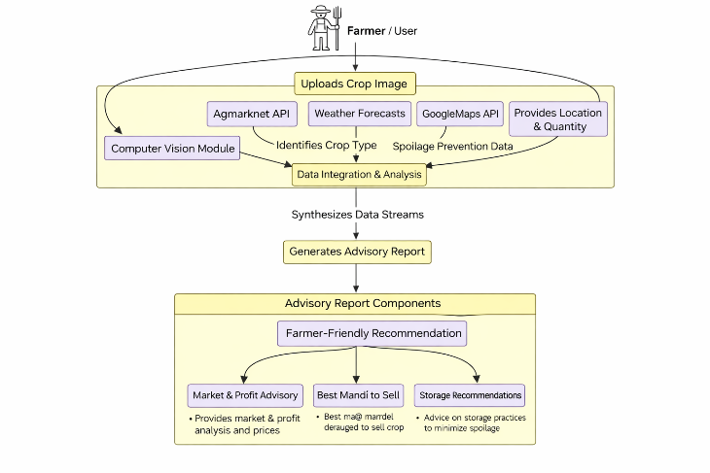
Data flow Diagram

Slide 10
Implementation Process
Requirement Analysis
Identifies farmer needs like price comparison, market selection, and storage decisions.
2. System Design
Designs system architecture by dividing it into modules like input, processing, and output.
3. Frontend Development
Develops user interface using Streamlit (app.py) for input, navigation, and result display.
4. Backend Development
Implements Python modules and APIs for data processing, price, weather, and decision logic.
5. AI Model Integration
Integrates AI models for crop analysis, freshness detection, and intelligent recommendations.
6. Integration of Modules
Combines frontend, backend, APIs, and AI models for smooth data flow.

Slide 11
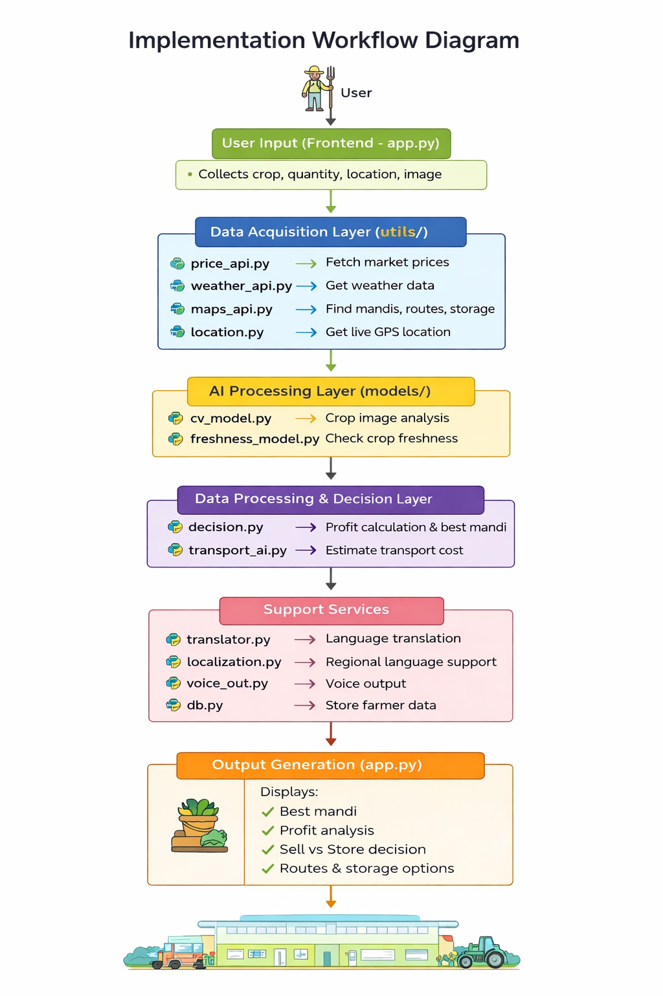
7. Testing and Validation
Performs testing to ensure system accuracy, performance, and reliability.
8. Deployment
Deploys the system as a Streamlit web application for user access.
9. Deployment
Deploys the system as a Streamlit web application for user access.

Slide 12
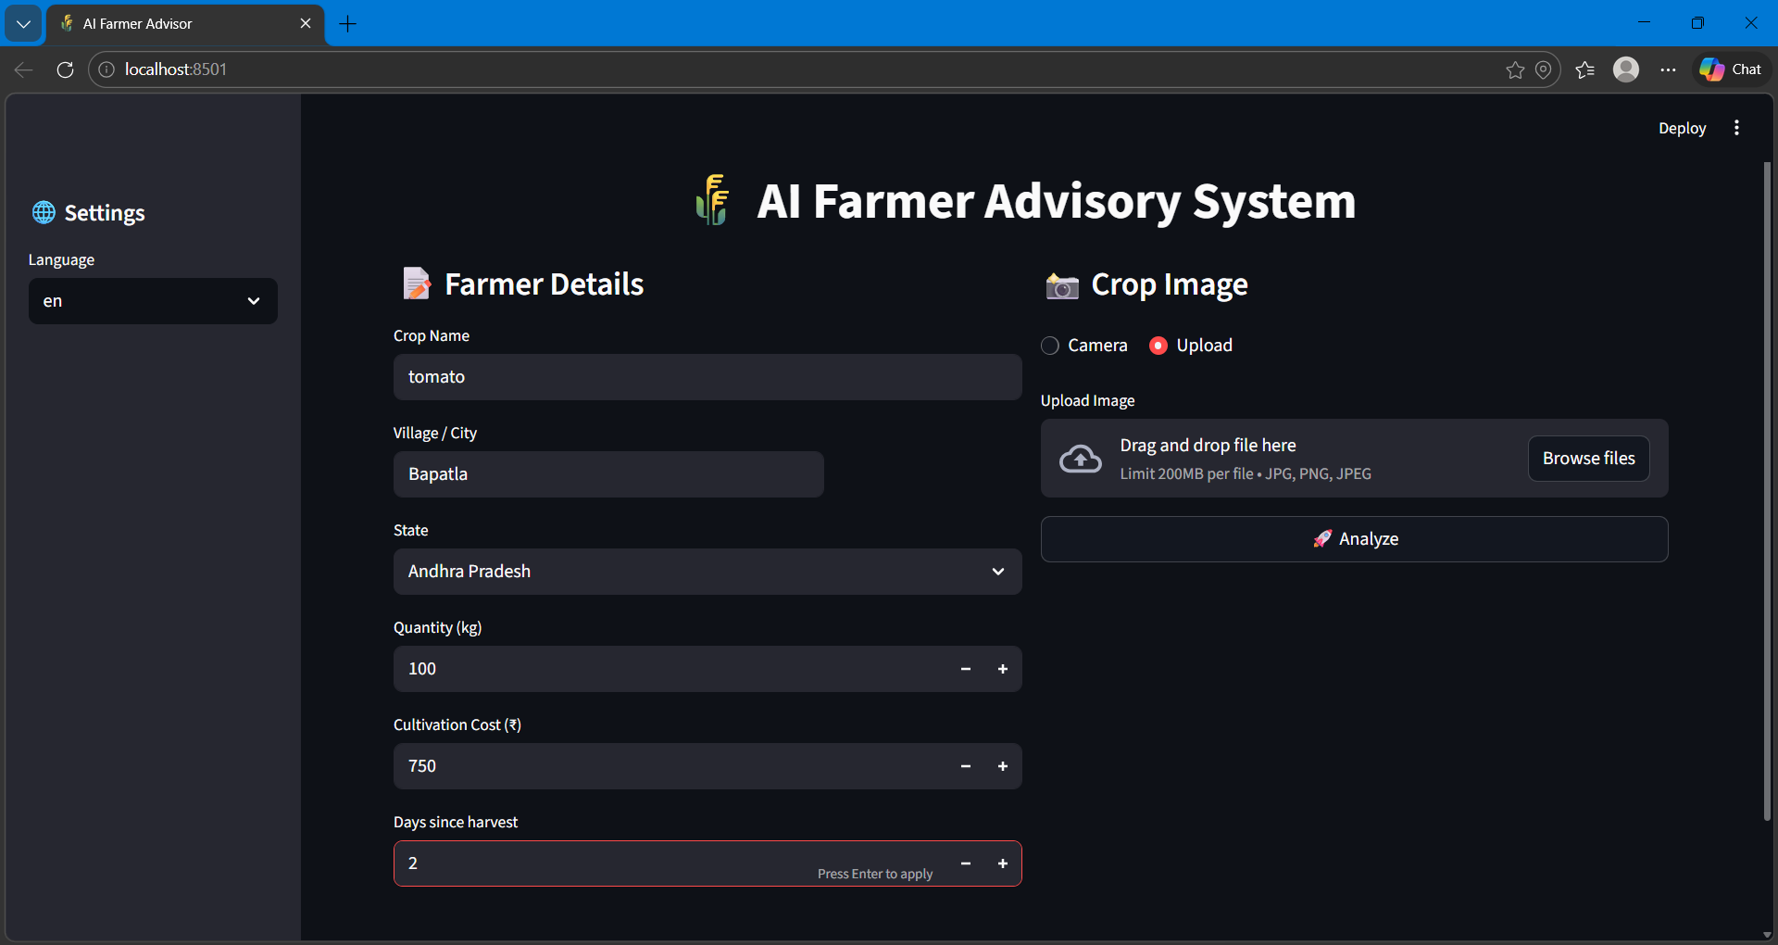
Results
The system was tested using real-time data to generate accurate profit-based recommendations for farmers.
5.1 Market Price Retrieval
Fetches real-time prices from Agmarknet
Filters and validates market-wise data
5.2 Profit Computation and Market Ranking
Calculates revenue and net profit
Ranks mandis based on profitability

Slide 13
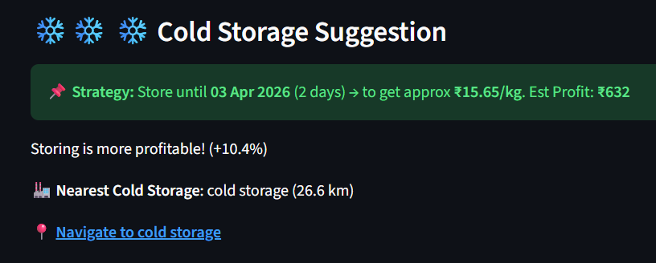
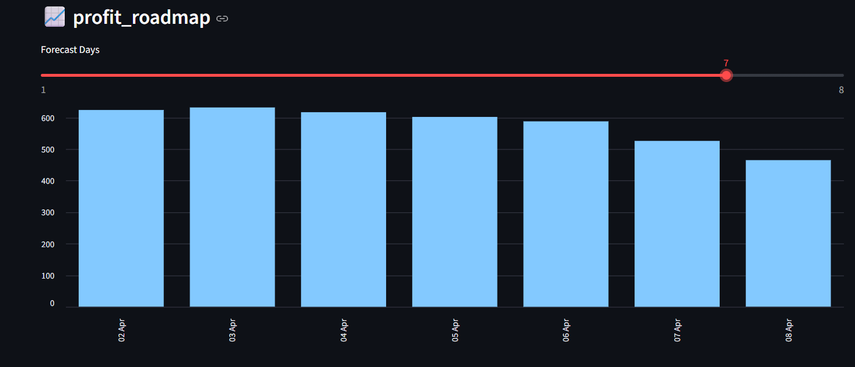
5.3 Cold Storage Analysis
Compares storage profit vs immediate selling
Suggests best decision based on profit
5.4 Profit Forecast Visualization
Shows profit trends over time
Simulates future selling scenarios

Slide 14
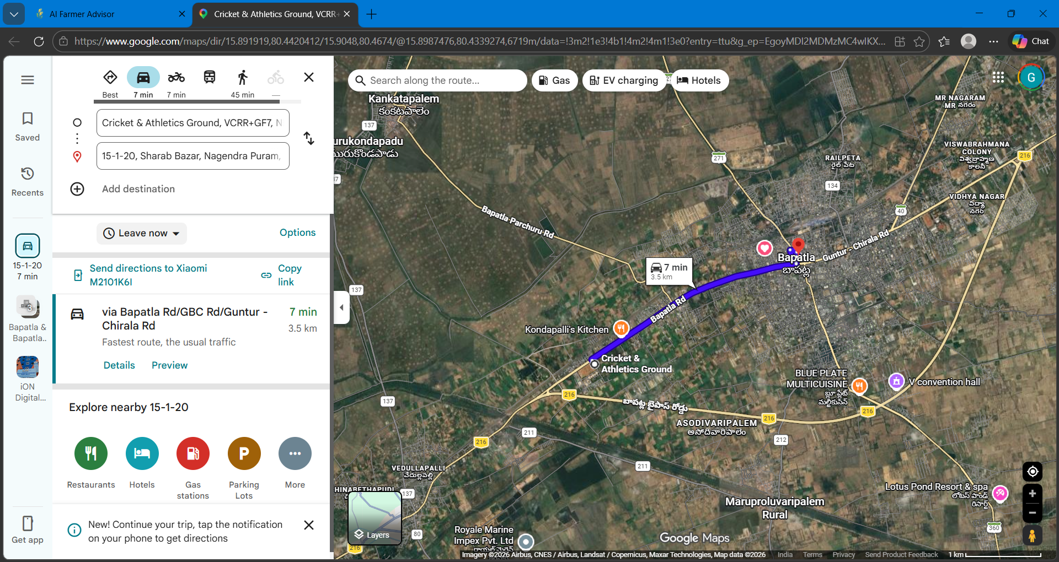
5.5 Route and Navigation Integration
Calculates distance and transport cost
Provides navigation for selected mandis
5.6 Overall Performance
Integrates price, transport, storage, and routing
Provides accurate and data-driven recommendations

Slide 15
Conclusion
This study presents an AI enabled farmer to market advisory framework integrating crop recognition, real time price intelligence, geospatial transport optimization, and storage profitability modelling. Experimental deployment demonstrates the feasibility of unified multimodal decision support in improving profit estimation and reducing post-harvest losses. While the proposed architecture advances integrated agricultural analytics, future work should focus on large scale validation, predictive accuracy benchmarking, and mobile deployment for rural accessibility. The findings reinforce the potential of AI driven economic advisory systems in strengthening data informed agricultural supply chain decision making.

Slide 16

Any Queries

Slide 17
THANK YOU

